Slide 1

Vegan Tourism: NYC vs Toronto

Slide 2

Vegan Tourists need more vegan friendly destinations
While travelling abroad, it is very difficult to find places that are vegan/vegetarian friendly and searching them up takes time and effort.
As the owner of a fictional travelling agency, my clients need to decide between NYC and Toronto, and the deciding factor for them is whether the place they’re travelling to has vegan food, and a variety of vegan food options.
I would therefore need to figure out which city has more vegan/vegetarian restaurants but also figure out which city has more variety.

Slide 3
Data Acquisition and Cleaning
Obtained the New York and Toronto Neighborhood datasets with and Lat-Long Coordinates from two sources, Course provided source for the New York Data, and scraped from Wikipedia and course provided source for the Toronto data.
After Grabbing the Neighborhood datasets, I obtained venue data by running the data through the Foursquare Places API.
The venue data was more than we needed, and we needed to therefore narrow it down to just vegan/vegetarian restaurants in the area. So I filtered the data even further to obtain the vegan/vegetarian restaurants in each city.
The venue data for each city contains 7 features, and the most important feature is the venue category which allowed us to filter by vegan/vegetarian restaurants.

Slide 4
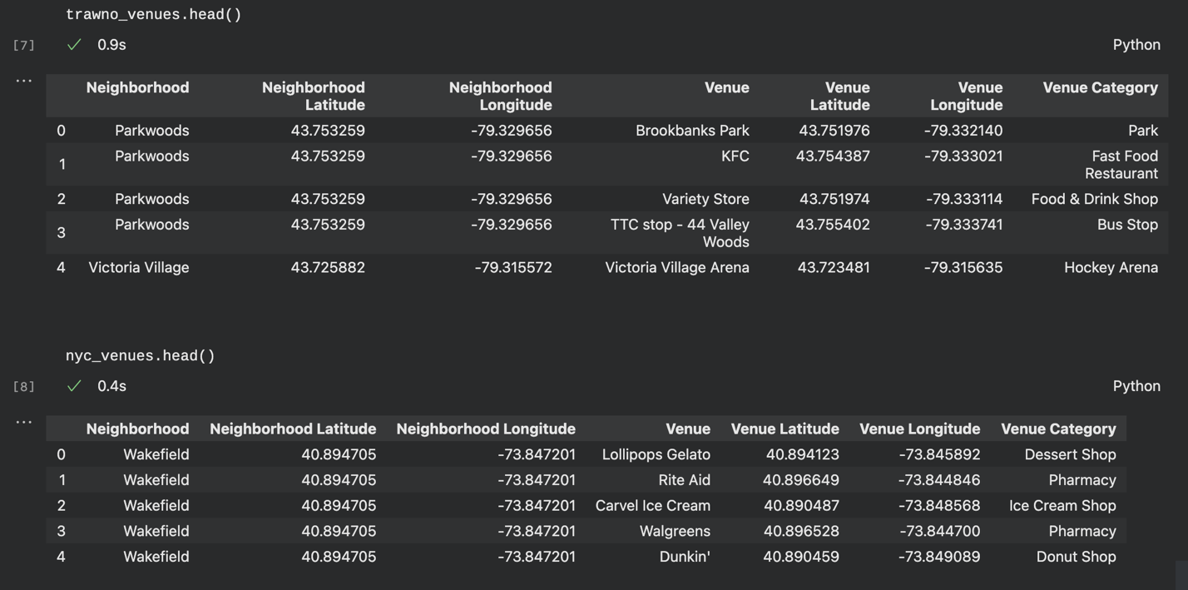
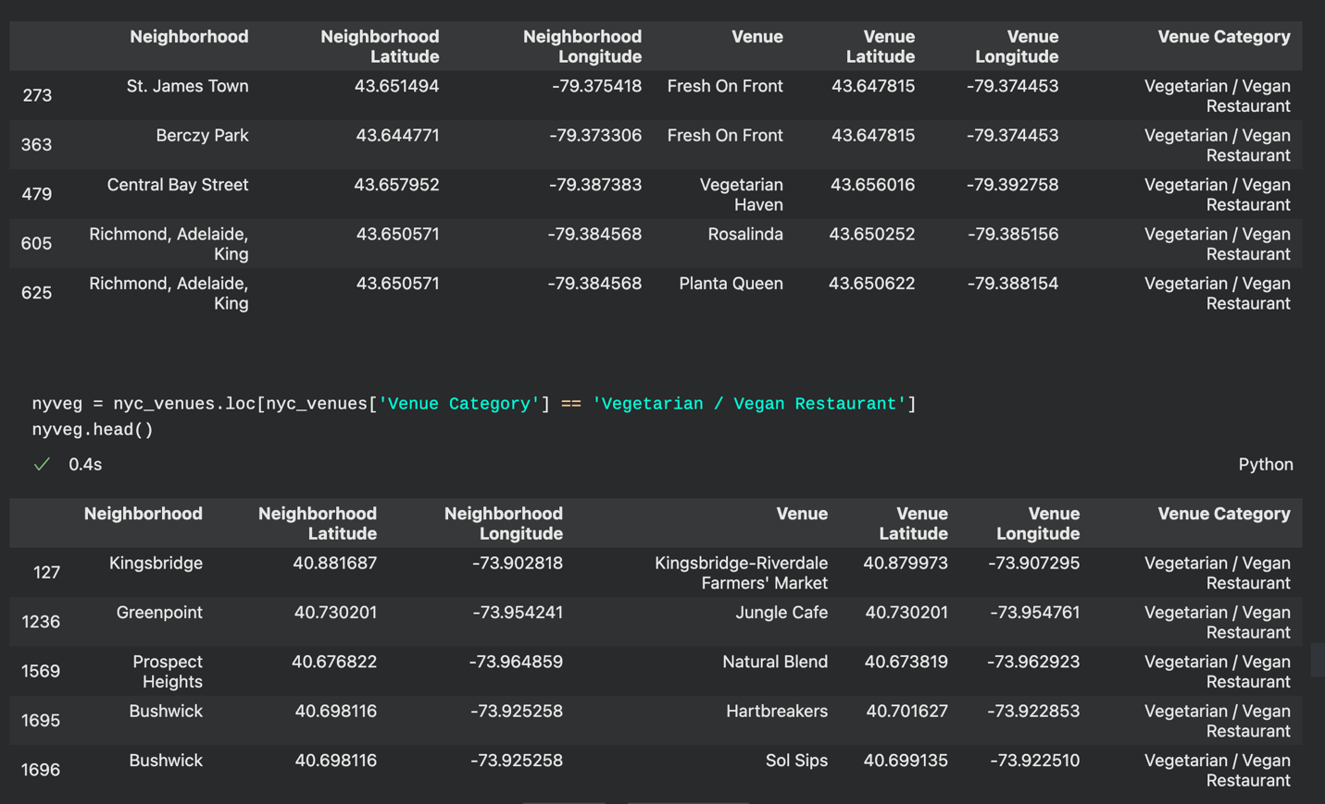
Datasets
Venue dataset pre filtering
Venue Dataset Post filtering for ‘Vegetarian / Vegan Restaurant”
Note: Some places might be chains, and would therefore have multiple locations, and as a result should not be marked as duplicates.

Slide 5
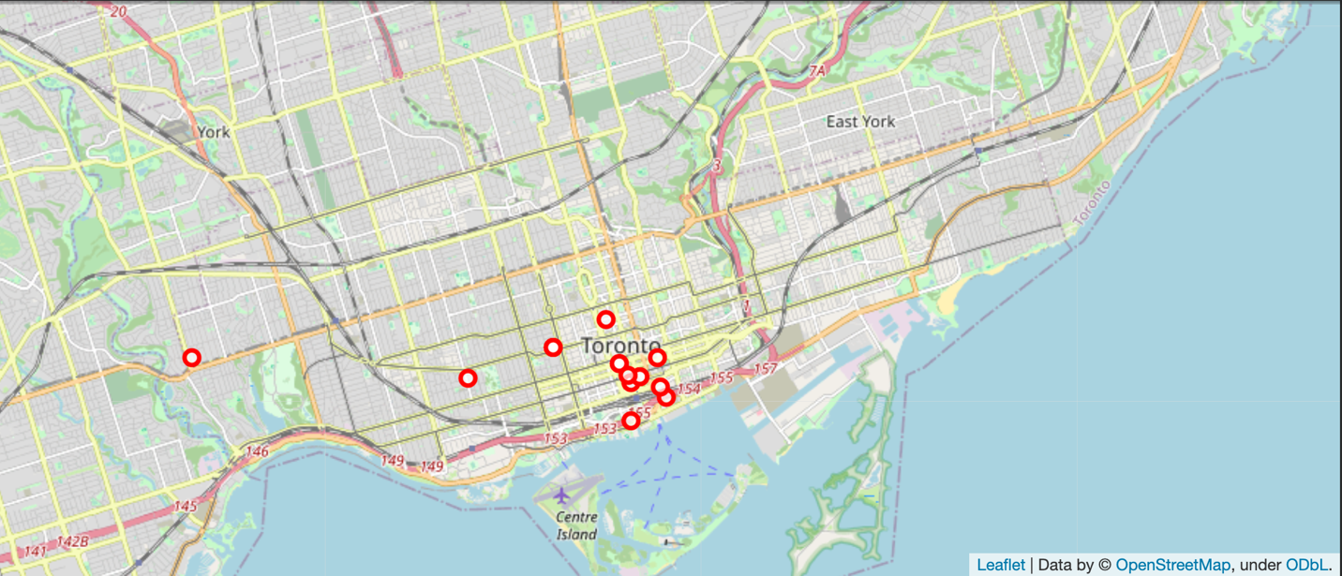
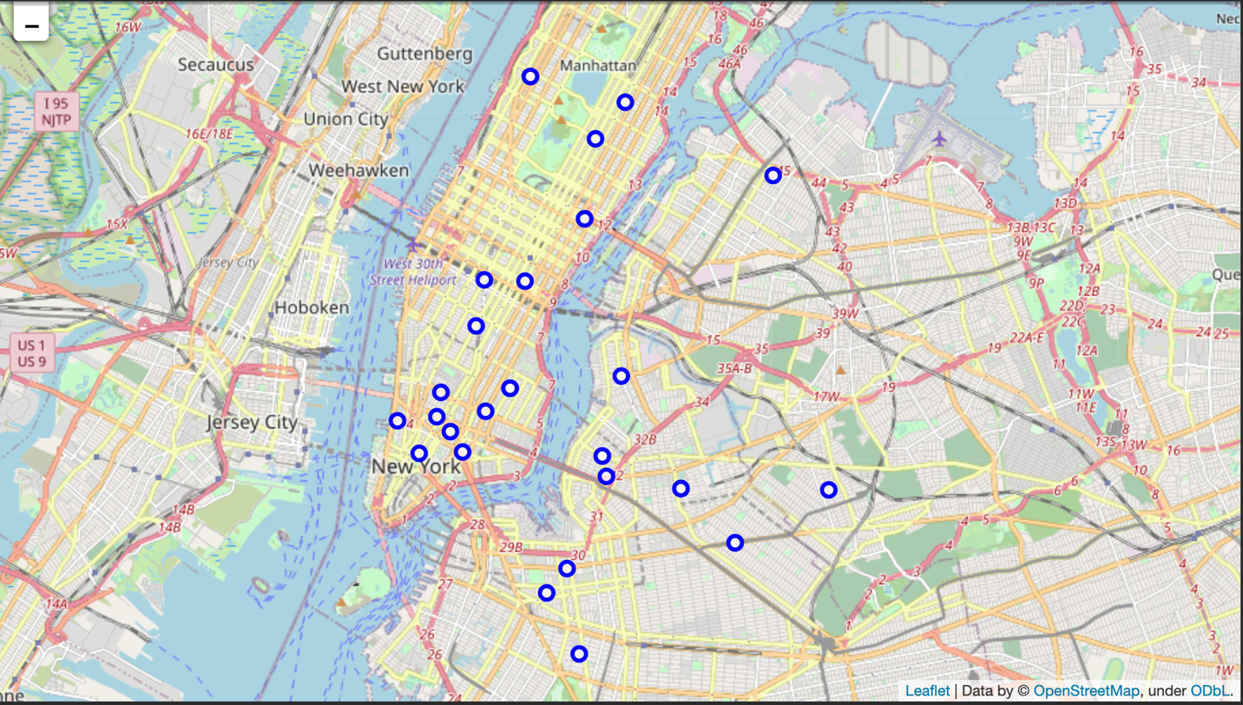
Maps
Map of Toronto
Map of New York City
New York City clearly has more options for vegan tourists, and there is a good spread, so it will give people the incentive to explore the city more knowing that they have food options wherever they are travelling to.

Slide 6
Conclusion/ Future Thoughts
I only focused on purely vegan/vegetarian restaurants and didn’t include restaurants which might have vegan/vegetarian options in addition to their non-vegetarian options. As a result, I might have eliminated some viable options for my clients.
However, based on the sheer number of vegetarian options, I believe that even if they wanted a little more variety, there are a ton of options on the list and that NYC is very, very vegan friendly.
I can confidently recommend New York City as the better option for my clients to travel to for the future and can use this approach to evaluate other cities for vegan friendliness and travel viability.
I could also adjust the approach to check for restaurants that match the customers preferred cuisine and/or create food-based tours where the main focus is travelling and sampling famous local joints and eateries, thus making my package options very diverse, while offering a special theme that other places might not have.

